Slide 1
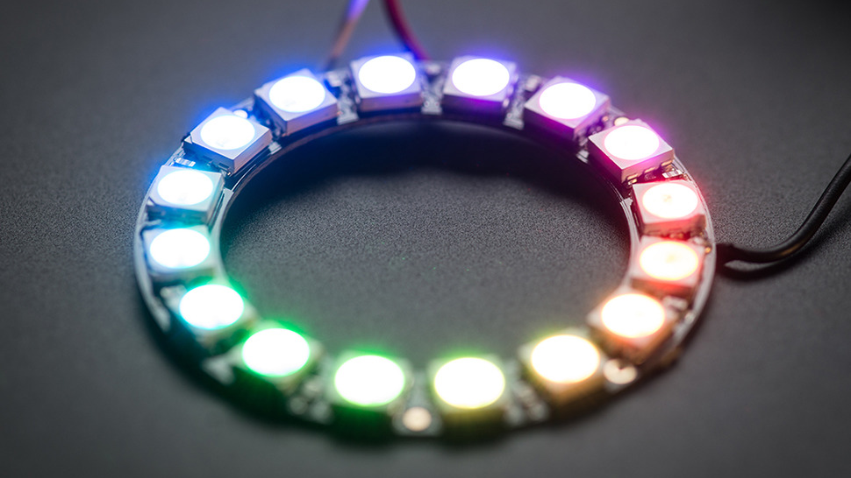
Raspberry Lites
Team Members:
Jeron Clarke
Genesis Knight
Ricardo Calderon

Slide 2
What Is Tap?
TAP
TAP stands for Technology Ambassador Program
TAP is funded by the STARS organization which is a computing corporation that provides training, resources, and community for broadening participation in computing.
Goals
Increasing the number of students who persist in an IT major or minor, particularly those underrepresented in the computing field.

Slide 3


Goals
Our project is tailored for students k-12 that are curious or aspiring to be IT professionals.
We Want our project to demonstrate the collaborative impact of using different technologies together to achieve a common goal.

Slide 4
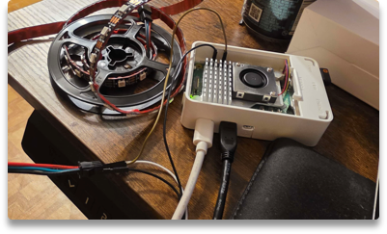
Raspberry Lites
What are we doing?
What technology are we using?
What are we teaching?
We want to create a real-life lightshow with the use of Python computer language to demonstrate how programming has more utilization that just software and web applications.
The technology being used are:
Minicomputer called a Raspberry Pi
USB mouse and keyboard
Python programming language
Addressable LED strips.
We want to educate the use of functions and algorithms in our code and how they can be used for creating our own unique light show.

Slide 5
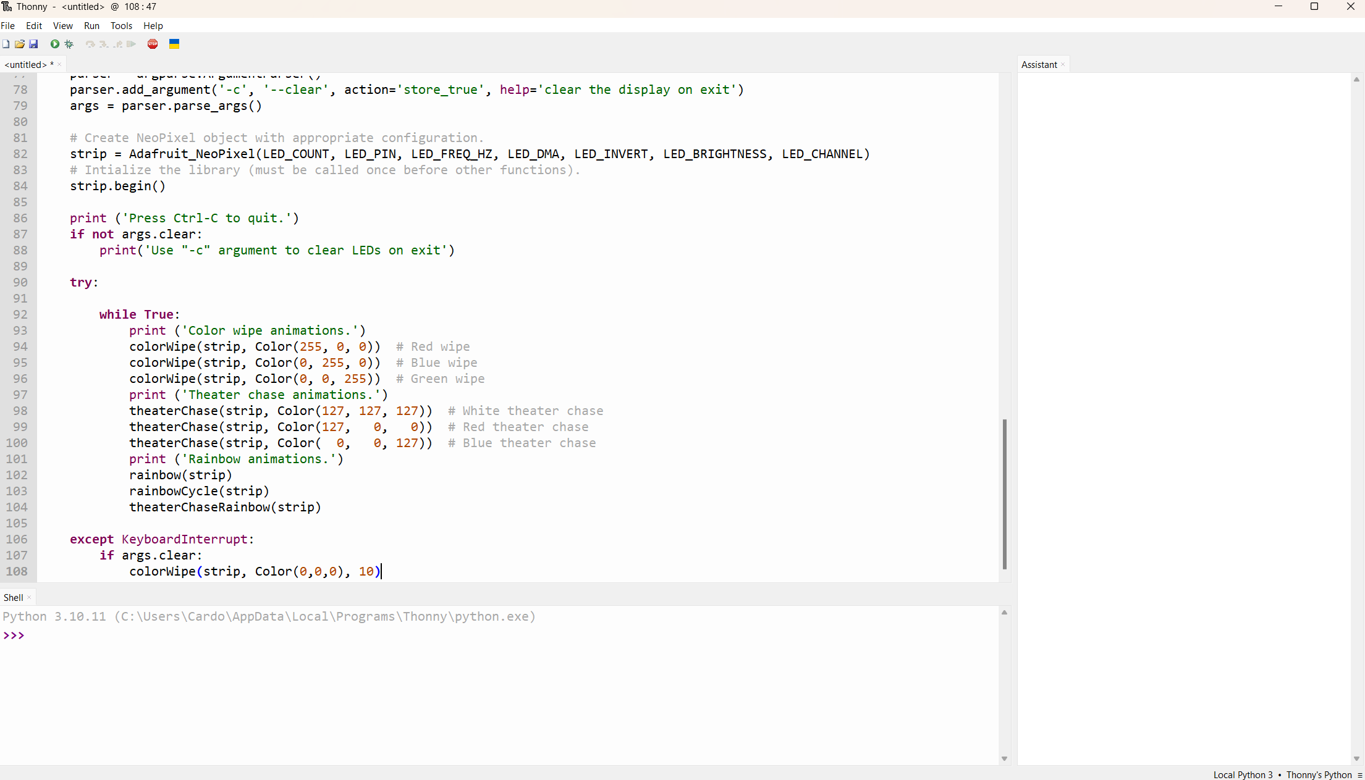
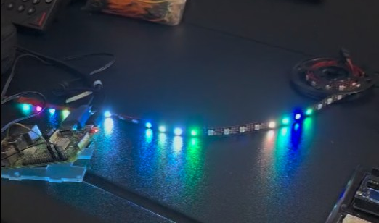
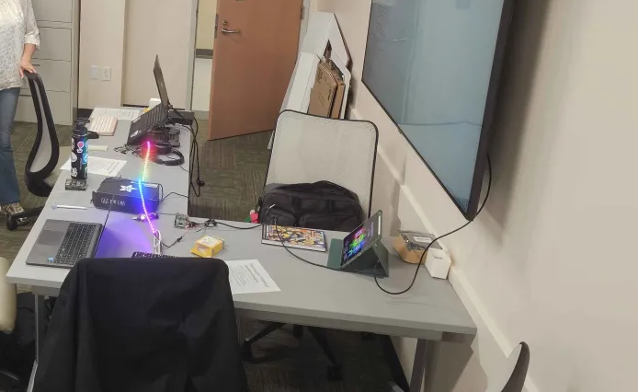
Raspberry Lites Workshop
Check out the code!
Get Creative
Execute the code!
Students will get to see the inner workings of the Python code and get to ask questions about how it works.
They can then interact with the graphical interface to work on their own algorithms.
After the students create their own functions on the Python script, they will get to execute the code and see the different colored lights that their code creates.

Slide 6
Please fill out our survey! It means a lot to us!
[placement for link or QR code]
We will appreciate your honest feedback!

Slide 7
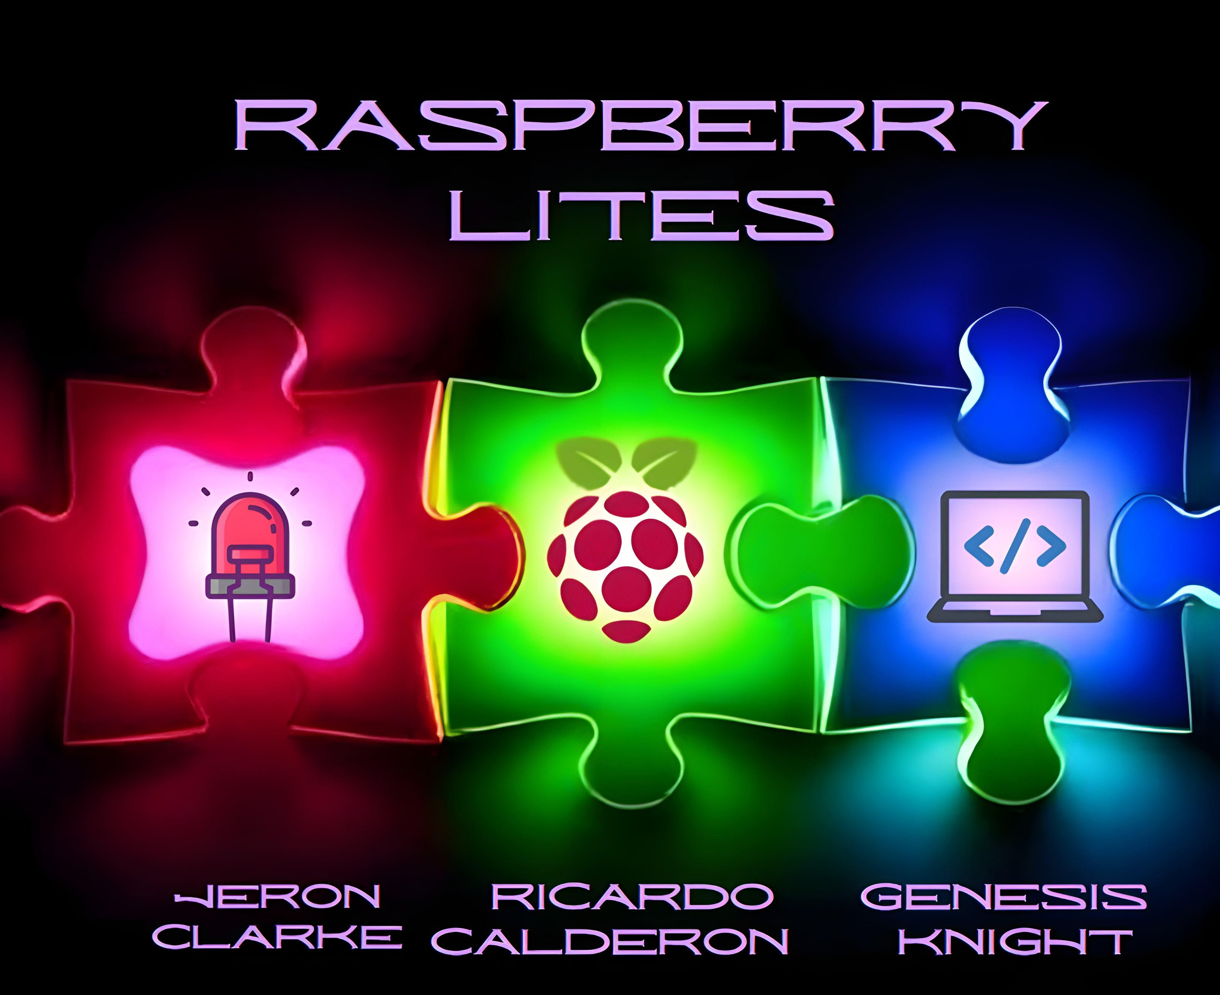
Thank you! :) Questions?

